Slide 1


CAPSTONE PROJECT
AMAZON SALES ANALYSIS PROJECT USING POWER BI
Presented By
Student Name: UJJURI SAISRI
College Name: AVANTHI’S ST.THERESSA INSTITUTE OF ENGINEERING & TECHNOLOGY
Department: CSE(AI&ML)
Email ID: saisriujjuri206@gmail.com

Slide 2
OUTLINE:
Problem Statement
Proposed System/Solution
System Development Approach
Algorithm & Deployment
Result
Conclusion
Future Scope
References

Slide 3
Problem Statement:
With the rapid growth of e-commerce platforms like Amazon, a large amount of product data such as pricing, discounts, and customer ratings is generated daily. Analyzing this data manually is difficult and time-consuming. Businesses need a clear understanding of product performance and customer preferences to make better decisions. Therefore, there is a need for a data analysis system that can transform Amazon product data into meaningful insights using visual dashboards.

Slide 4
Proposed Solution:
The proposed system aims to analyze Amazon product data and provide meaningful insights through an interactive Power BI dashboard. This involves using data analytics and visualization techniques to understand product performance, pricing trends, discounts, and customer ratings. The solution consists of the following components:
Data Collection:
Collect Amazon product dataset containing details such as product name, category, actual price, discounted price, ratings, and review counts.
Data Preprocessing:
Clean and transform the dataset by removing unnecessary symbols, converting text values into numerical format, and handling missing or inconsistent data to ensure accurate analysis.
Dashboard Development:
Create an interactive Power BI dashboard with visualizations such as KPI cards, bar charts, pie charts, donut charts, and line charts to present insights like product distribution, rating trends, and price comparisons.
Deployment:
The dashboard can be shared through Power BI reports, enabling users to easily explore and analyze Amazon product data for better understanding of sales patterns and product performance.

Slide 5
The dashboard provides:
• Total number of products available
• Average product ratings
• Average discounts offered
• Category-wise product distribution
• Comparison of actual price vs discounted price
• Identification of top-rated products
This helps users easily understand sales trends and product performance.

Slide 6
System Approach:
The system approach describes the overall methodology used to develop the Amazon Sales Analysis Dashboard. The main objective is to analyze Amazon product data and present useful insights through interactive visualizations in Power BI.
System requirements
Hardware Requirements
Computer/Laptop with minimum 4GB RAM
Intel i3 processor or above
Minimum 10GB free storage
Software Requirements
Microsoft Power BI Desktop
Microsoft Excel / CSV dataset
Windows Operating System
Library required to build the model
The following tools and components are used to develop the Amazon Sales Analysis Dashboard:
Power BI Desktop – Used to create interactive dashboards and visualizations.
Power Query Editor – Used for data cleaning, transformation, and preprocessing.
Dataset (Amazon product dataset) – Used as the input data for analysis.
DAX (Data Analysis Expressions) – Used for creating calculated measures and aggregations.

Slide 7
The development of the dashboard follows these steps:
1. Data Collection
Amazon product dataset containing product name, category, price, discount, rating, etc.
2. Data Cleaning
Removed currency symbols
Converted text values into numerical format
Handled missing or incorrect values
3. Data Analysis
Calculated averages
Counted products by category
Compared price and discount
4. Visualization
Built interactive charts and KPI cards using Power BI.

Slide 8
Algorithm & Deployment:
Analysis Method Selection:
The project uses data visualization and analytical techniques in Power BI to analyze Amazon product data. Power BI was selected because it provides powerful tools for transforming raw data into meaningful visual insights through interactive dashboards.
Data Input:
The dataset used for this analysis includes the following features:
product_id, product_name, category, actual_price, discounted_price, discount_percentage, rating, and rating_count. These attributes help analyze product performance, pricing patterns and customer satisfaction.
Data Processing:
The dataset is cleaned and transformed using Power Query. This includes removing currency symbols, converting text data into numerical format and handling missing or inconsistent values to ensure accurate analysis.
Visualization Process:
After preprocessing, the data is visualized using Power BI charts such as KPI cards, bar charts, column charts, pie charts, donut charts, and slicers. These visualizations help users easily understand trends like product distribution, pricing comparisons and top-rated products.

Slide 9
DASHBOARD VISUALIZATIONS
The dashboard contains the following visualizations:
📊 KPI Cards
Total Products
Average Rating
Average Discount
Average Discount Percentage
📊 Bar Chart
Number of products by category
📊 Column Chart
Actual Price vs Discounted Price
📊 Bar Chart
Top Rated Products
📊 Pie Chart
Rating distribution
📊 Donut Chart
Top product categories
📊 Line Chart
Average rating by category
📊 Slicer
Filter data by category

Slide 10
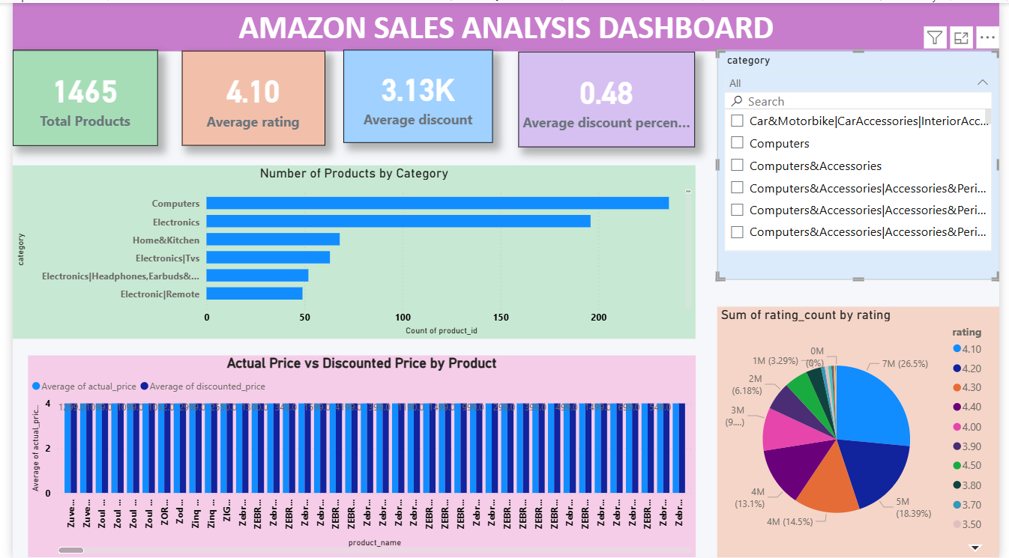
ResultS:
The developed Amazon Sales Analysis Dashboard successfully provides meaningful insights from the Amazon product dataset using interactive visualizations. The dashboard displays important metrics such as total number of products, average ratings, and discount percentages. Different charts help analyze product distribution, price comparison, and rating trends effectively.
Fig1: Amazon Sales Dashboard – Overview

Slide 11
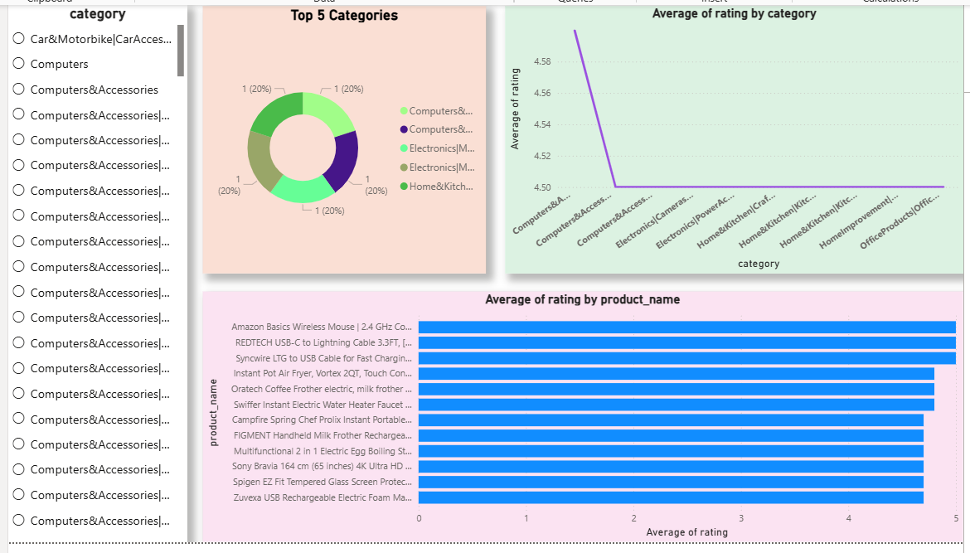
Fig 2: Amazon Sales Dashboard – Category and Rating Analysis

Slide 12
Conclusion:
The Amazon Sales Analysis Dashboard successfully transforms raw product data into meaningful insights using Power BI visualizations. The dashboard helps analyze product categories, pricing differences, discounts, and customer ratings effectively. During the implementation, challenges such as data cleaning and format conversion were handled using Power Query. The developed dashboard makes it easier to understand product performance and customer preferences. This analysis helps in making better data-driven decisions for e-commerce platforms.
Using Power BI visualizations, users can quickly analyze:
Product categories
Price differences
Customer ratings
Discount trends
This dashboard helps businesses make better decisions based on data analysis.

Slide 13
Future scope:
The project can be further enhanced with the following improvements:
• Integration with real-time Amazon sales data for live analysis
• Addition of sales revenue and profit analysis for better business insights
• Use of advanced analytics and machine learning techniques
• Prediction of future sales trends and customer preferences
• Development of a web-based dashboard for real-time business monitoring

Slide 14
References:
Kaggle – Amazon Product Dataset: Dataset used for analyzing product details such as price, discount, category, and customer ratings.
Amazon Dataset Link:
https://www.kaggle.com/code/mehakiftikhar/amazon-sales-dataset-eda/input
GitHub Repository Link:
https://github.com/saisree1431/Amazon-Sales_Analysis-Project-using-Power-BI

Slide 15
Thank You

